Slide 1
Welcome to the Trenholm Library

Slide 2
Trenholm Library 1st Floor

Slide 8
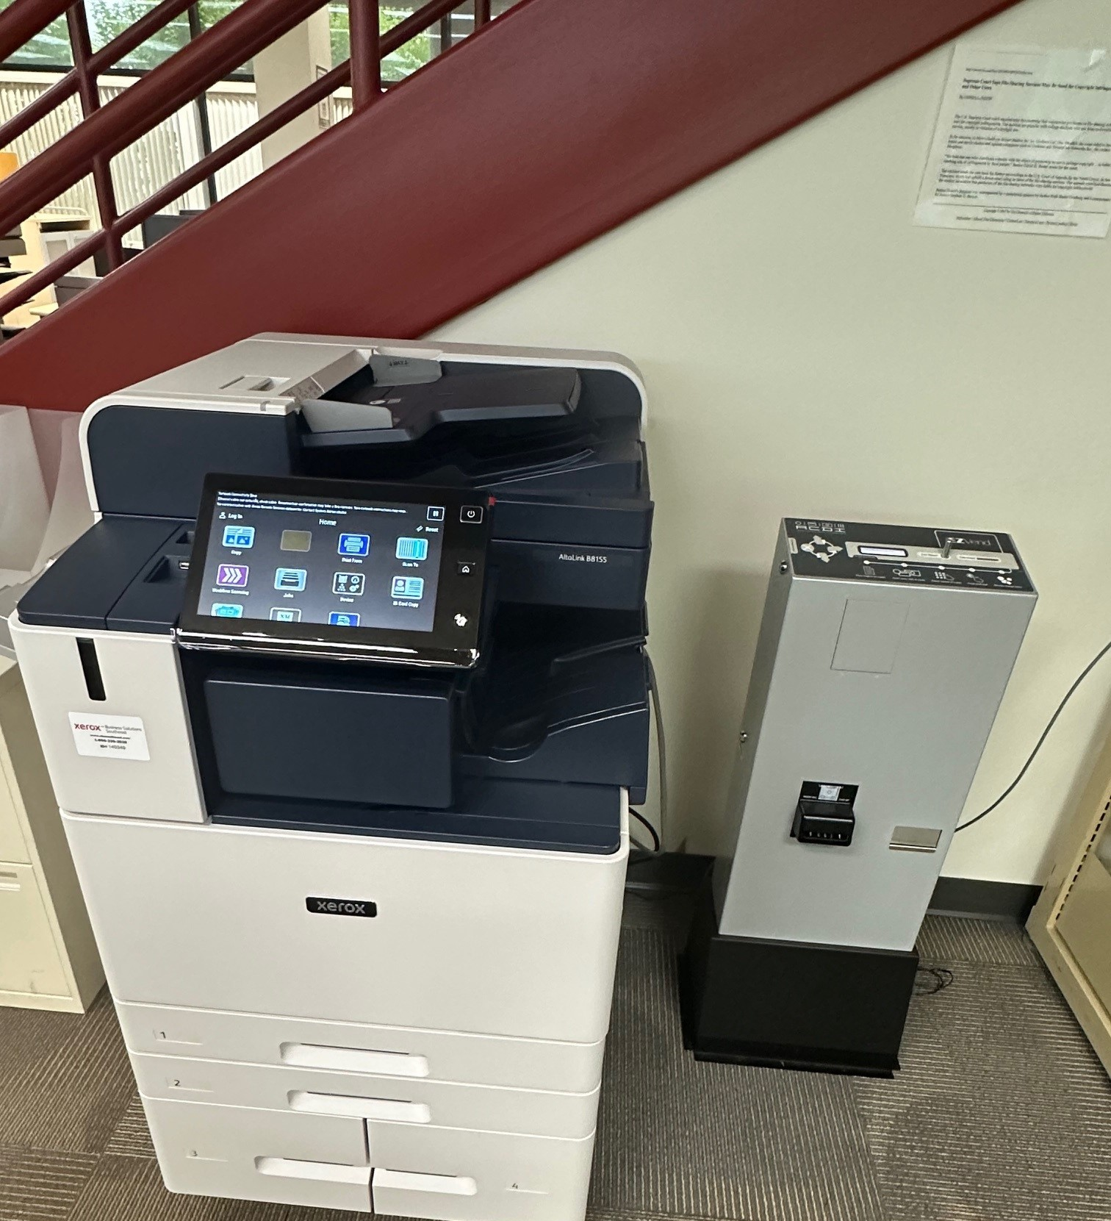
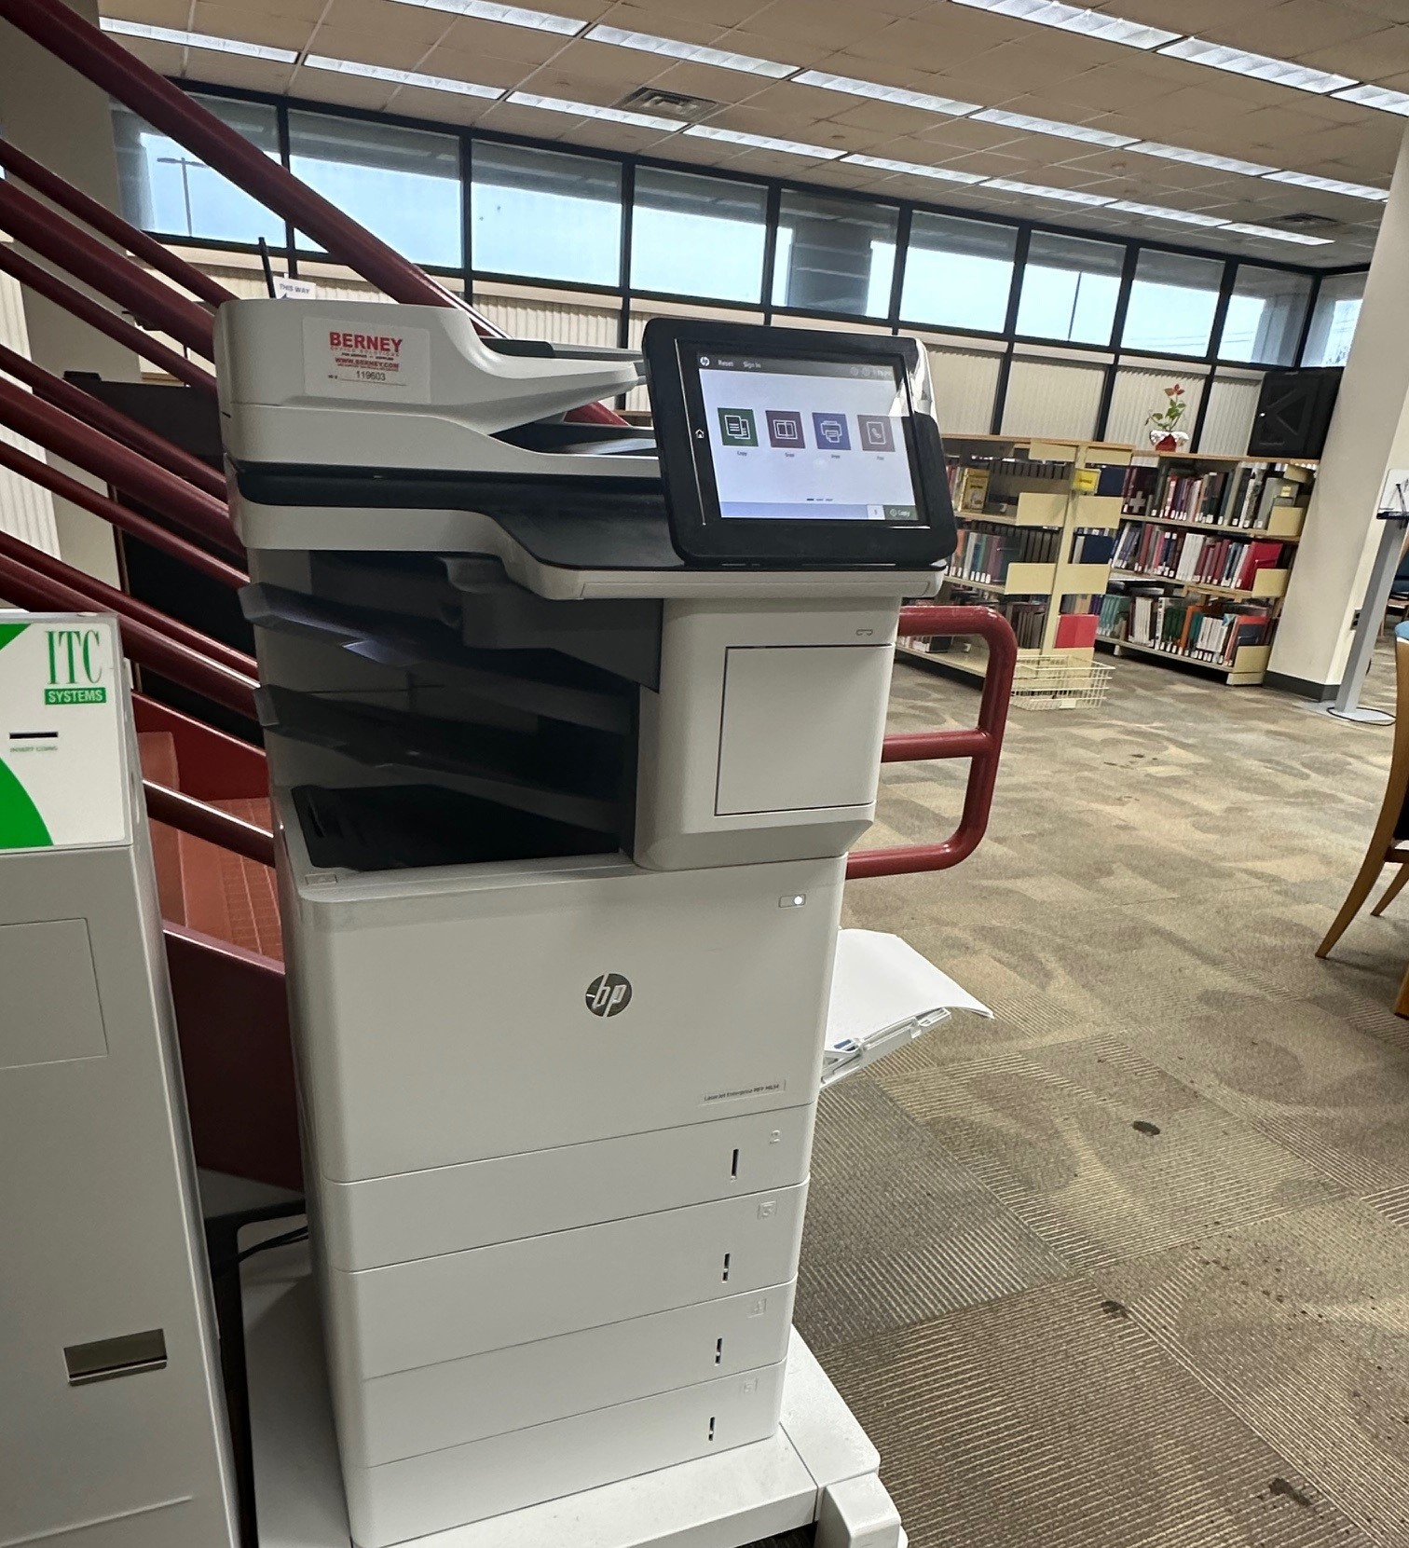
Student Printer
Student Copier

Slide 9
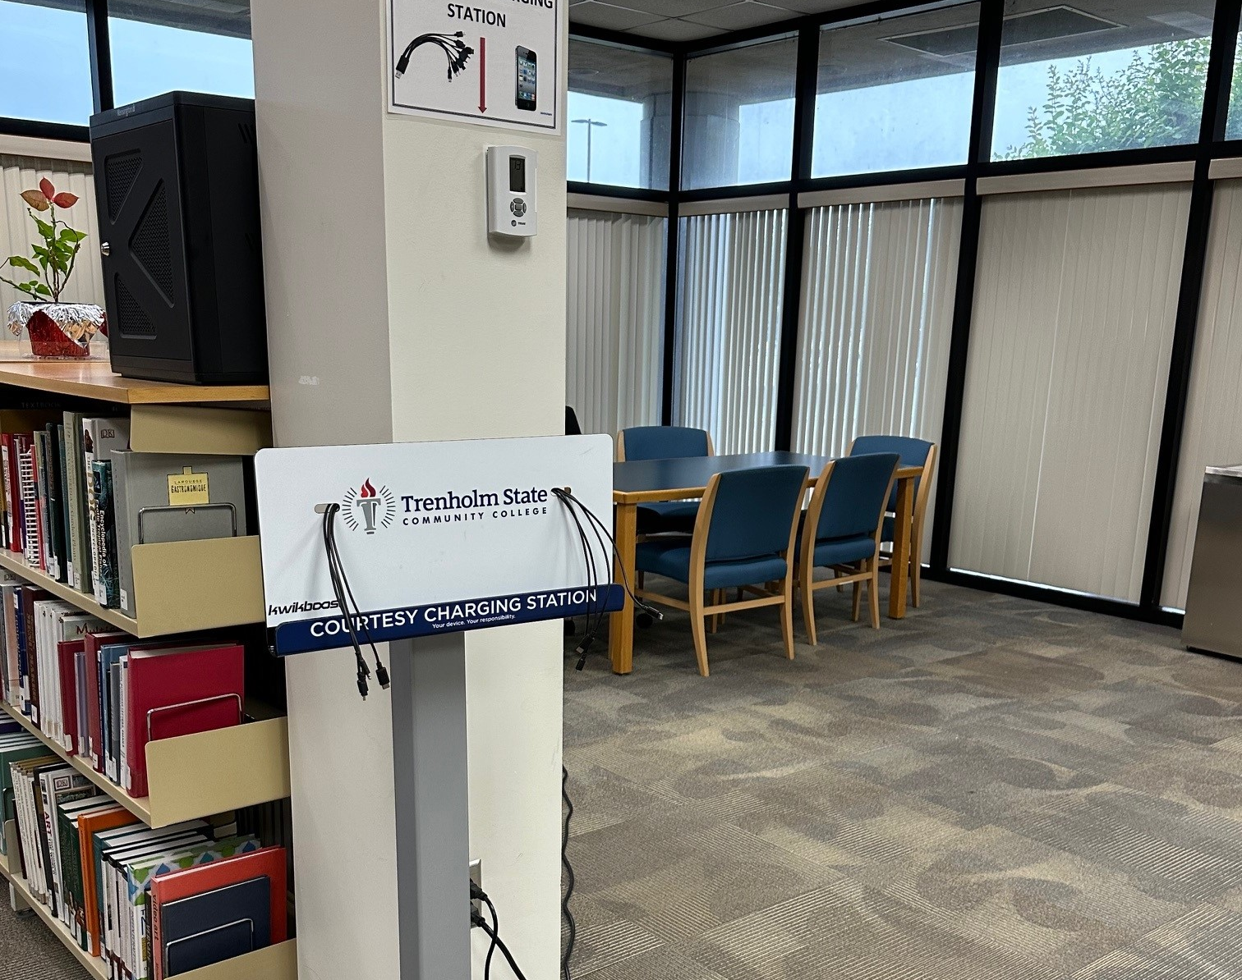
Charging Station

Slide 10
Trenholm Library 2nd Floor

Slide 13
Conference Room

Slide 14
Two Study Rooms

Slide 15
Library Computer Lab 2nd Floor, Room 212

Slide 18
Quiet Study Room 3rd Floor, Room 314

Slide 22
Trenholm Library Locations
Trenholm Campus
Library Tower
3086 Mobile Highway
Montgomery, AL 36104
334-420-4456
Patterson Site
Building E, Room 119
3920 Troy Highway
Montgomery, AL 36116
334-420-4357
Library@trenholmstate.edu
https://library.trenholmstate.edu/

